Slide 1

Your past. Your present. Your future.
Notes:
I would like you to try and remember your happiest memory. Now, think about yourselves 40 years from now. You may no longer remember that moment. Wouldn’t you like to capture those moments and relive them in the future? That’s what Capsulefy is about.

Slide 2
OVERVIEW
Idea
Team
MVP
Technologies
Viability study
Competitors
Pilot users
Planification
Costs
Profit estimations

Slide 3
IDEA

Slide 4





IDEA

Slide 5
TEAM

Slide 6
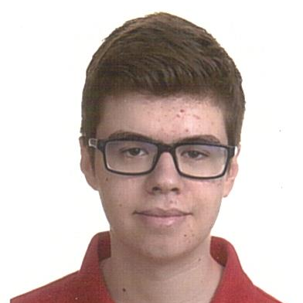



TEAM
Pablo Rebollo
Project manager, backend developer

Slide 7
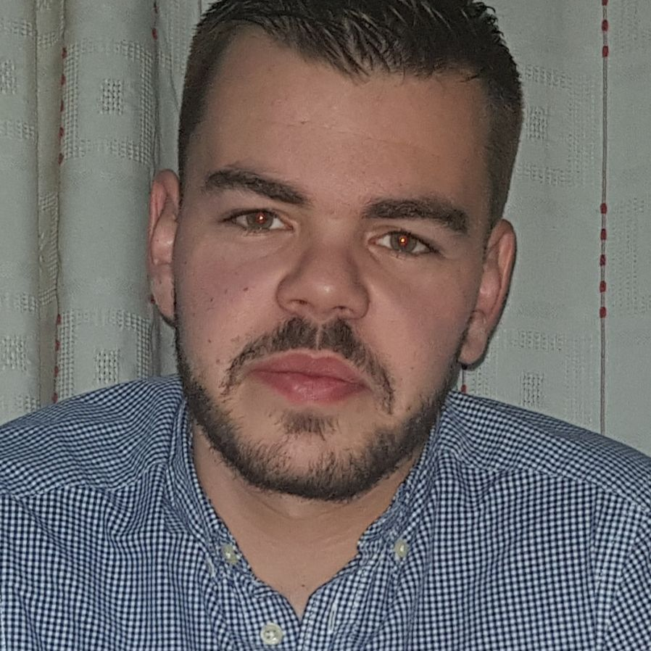


TEAM
Adrián Cantón
Business manager, full-stack developer

Slide 8
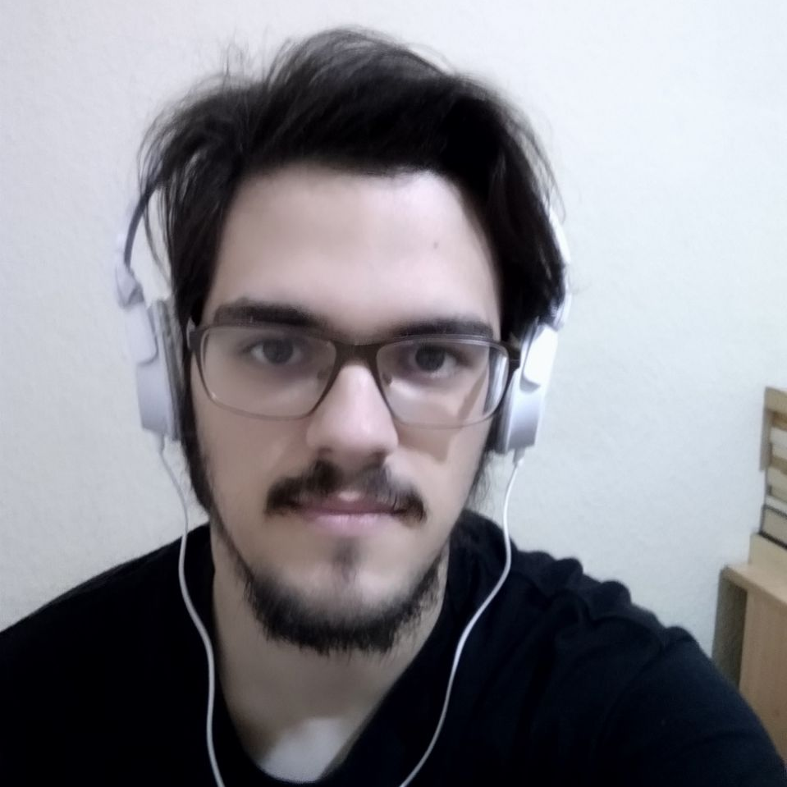

TEAM
Daniel Carpio
Analist, frontend developer

Slide 9


TEAM
Juan Rodríguez
Requirements engineer, backend developer

Slide 10


TEAM
Rafael Fresno
Backend developer, API integration

Slide 11




GOALS

Slide 12




KNOWLEDGE MANAGEMENT

Slide 13
MVP

Slide 14

CLASSIFICATION
=

Slide 15
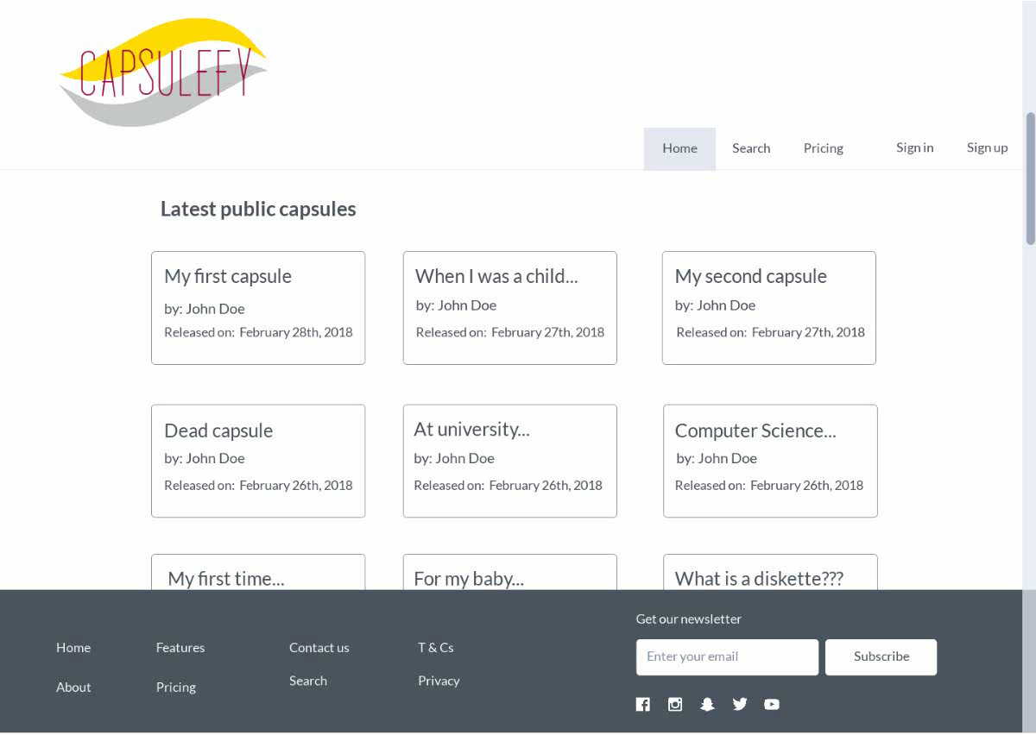
No logged user

Slide 16
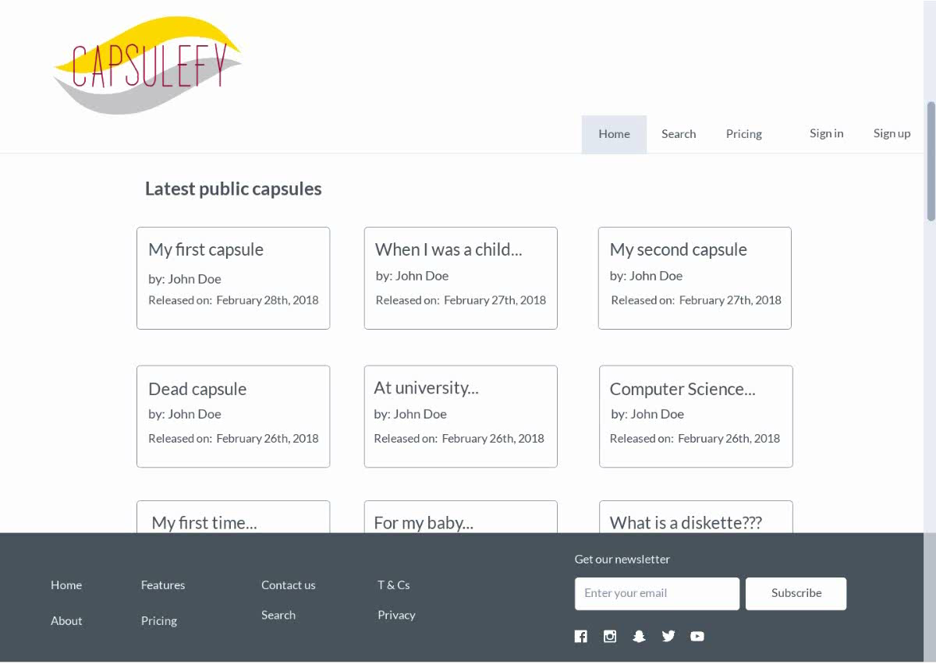
Logged-in user

Slide 17
TECHNOLOGIES

Slide 18





TECHNOLOGIES
Main web app
Users and capsules APIs
Social media APIs

Slide 19

TECHNOLOGIES
?

Slide 20



ALM

Slide 21
VIABILITY STUDY

Slide 22
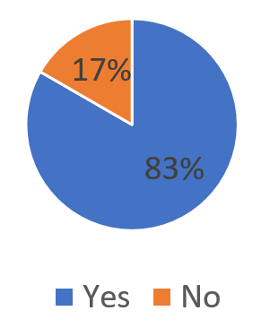
Do you know what a time capsule is?

Slide 23
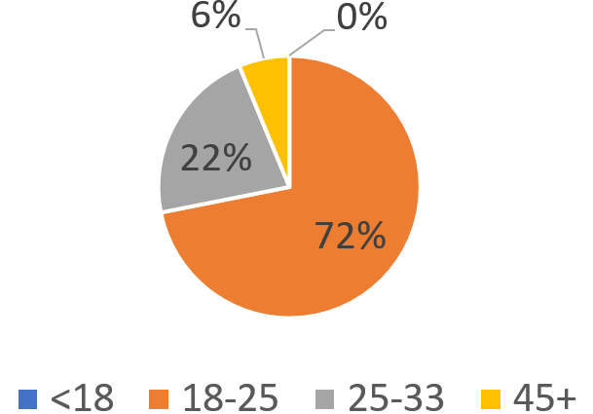
What is your age?

Slide 24
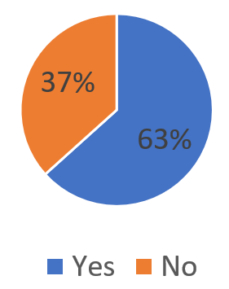
Are you interested in our idea?

Slide 25
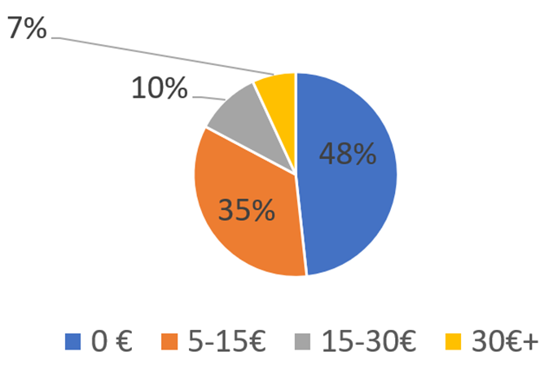
How much would you pay yearly?

Slide 26
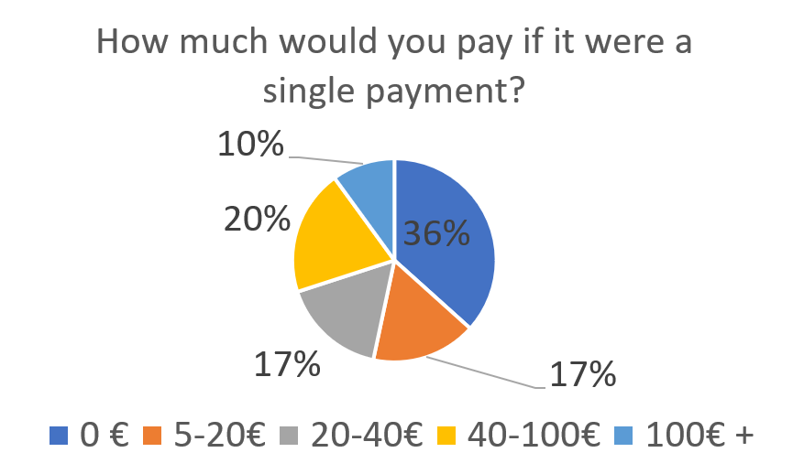
How much would you pay if it were a single payment?

Slide 27
COMPETITORS

Slide 28


COMPETITORS
 | Viajeros en el tiempo | Mytimecapsule | Miigen | thetimecapsule | Capsulefy
Automatic content publication
Free version
Premium version
Images
Videos
Social network interaction
Dead man switch

Slide 29




SWOT MATRIX
STRENGTHS | WEAKNESSES
OPPORTUNITIES | THREATS

Slide 30
PILOT USERS

Slide 31
PILOT USERS
Name | Age
Francisco R. | 55
Javier A. | 19
Valentin A. | 19
Antonio G. | 26
Name | Age
José Manuel J. | 21
Sandra C. | 28
José Manuel D. | 21

Slide 32


COMMITMENT

Slide 33
PAYMENT PLANS
 | Free | Premium/Modular
Price | 0 € | 10 €/year
Space | 10 MB/user | 100 MB/capsule
Social network and email integration
Capsule scheduling | Up to 1 year | Depends on subscription
Open capsule duration | 6 months | 1 year after subscription expiration
Duration extension

Slide 34

PLANIFICATION
Each week
Sprint planning
Send deliverable
Each deliverable

Slide 35
PLANIFICATION
First sprint | Core use cases Piloting plan
Second sprint | Full MVP Feedback taken into account
Third sprint | Polished MVP

Slide 36
COSTS

Slide 37


COSTS
Realistic: 34348.71 – 43554.24 €
Optimistic: 27105.61 €
Pesimistic: 60474.63 €
Notes:
Factors taken into account: salaries, workplace, hosting, adversitement.

Slide 38
COSTS (REALISTIC 1)
Project duration | 4 months
Salaries (PM) | 30.50 €/hour
Salaries | 20.80 €/hour
Hours per month | 50
Equipment | 306.67 €
Hosting (1 year) | 526.56 €
Advertising (6 months) | 1800 €
Total | 34348.71 €

Slide 39
COSTS (REALISTIC 2)
Project duration | 5 months
Salaries (PM) | 30.50 €/hour
Salaries | 20.80 €/hour
Hours per month | 50
Equipment | 383.33 €
Hosting (1 year) | 526.56 €
Advertising (6 months) | 3000 €
Total | 43554.24 €

Slide 40
COSTS (OPTIMISTIC)
Project duration | 4 months
Salaries (PM) | 30.50 €/hour
Salaries | 20.80 €/hour
Hours per month | 40
Equipment | 306.67 €
Hosting (1 year) | 526.56 €
Advertising (6 months) | 900 €
Total | 27105.61 €

Slide 41
COSTS (PESIMISTIC)
Project duration | 6 months
Salaries (PM) | 30.50 €/hour
Salaries | 20.80 €/hour
Hours per month | 60
Equipment | 460 €
Hosting (1 year) | 526.56 €
Advertising (6 months) | 2400 €
Total | 60474.63 €

Slide 42




RISKS
Notes:
Computers not working, contracts changing, servers down, incompatible schedules, negative reception and losses.

Slide 43
PROFIT ESTIMATION

Slide 44
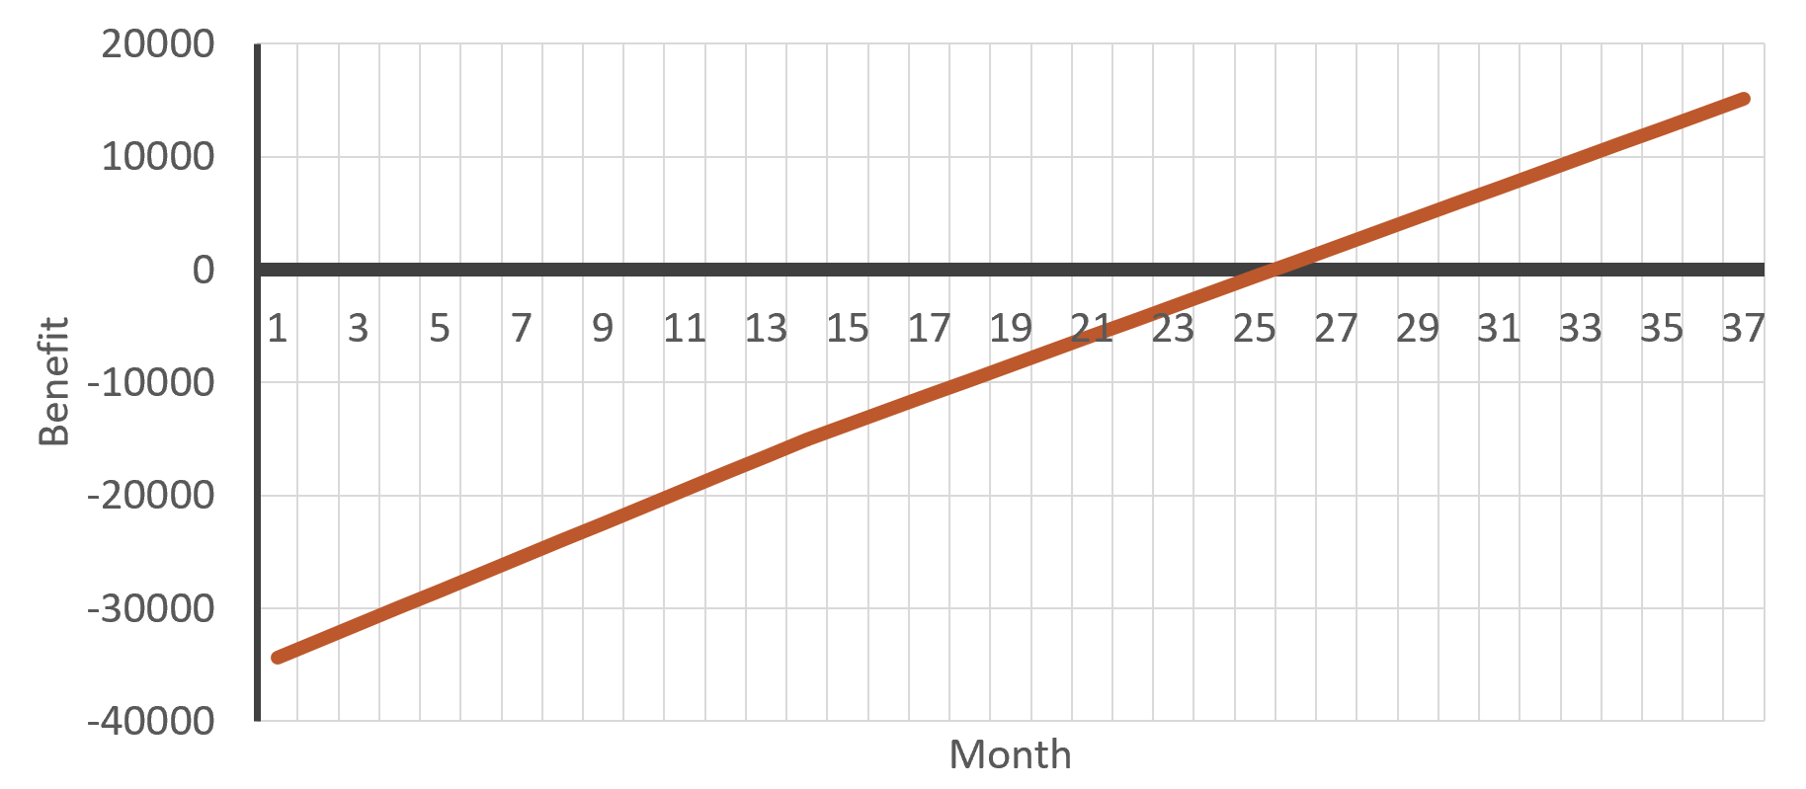
PROFIT ESTIMATION
2 users per day

Slide 45
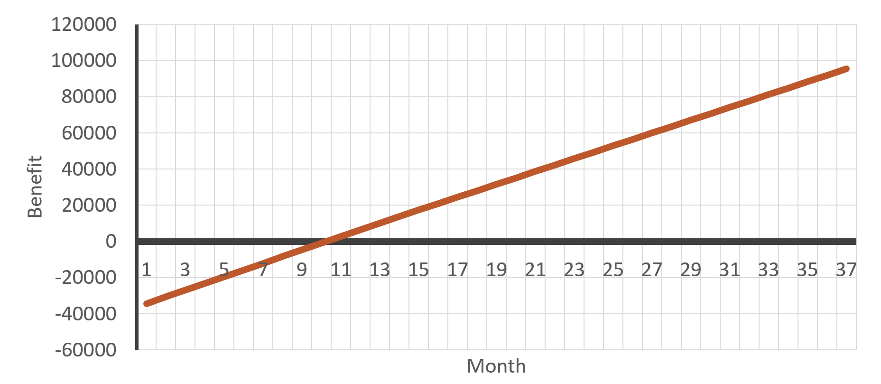
PROFIT ESTIMATION
5 users per day

Slide 46
THANKS!
Notes:
Insurance companies: offer capsules to their clients, with no expiration and special prices. Create endpoint for insurances to send their client data.

Slide 47

capsulefy.communications@gmail.com
https://marvelapp.com/4395g15/screen/53795517

Slide 48

CORE USE CASES
Refresh deadman switch
Select type of capsule
<<includes>>
Unregistered user
Registered user
Pay for a
capsule

Slide 49
CORE USE CASES
Delete
capsule
Create free
capsule
Unregistered user
View
capsule
Registered user

Slide 50
FIRST SPRINT
- Prepare development environment
- Implement data models
- Work on requirements
- Test the system
- Take actions according to feedback

